Slide 1



Componentizing ASP.NET MVC
Simone Chiaretta Solution Developer, Avanade
http://codeclimber.net.nz
27 Giugno 2009

Slide 2
Who the hell am I?
Simone Chiaretta
Lavoro per Avanade Italy
Microsoft MVP ASP.NET
Blogger – http://codeclimber.net.nz
Founder of UGIALT.NET
OpenSource developer
Climber
All Around Nice Guy

Slide 3
How to componentize ASP.NET MVC
RenderPartial
The controller must “create” all the data needed by all components
RenderAction (MvcFutures)
Smells (the view knows about the controller)
Difficult to test that the component is displayed
Custom HtmlHelpers
Good for building HTML, must not have logic
BAD
BAD
BAD
RenderPartial + Action Filters
Data “creation” is encapsulated, view is encapsulated
GOOD

Slide 4
What’s an action Filter
It’s an Attribute
Allows code execution (AOP style)
During the Authentication phase
When an Exception is thrown
Before an Action
After an Action
Before the rendering of a View
After the rendering of a View
“Core” filters
Authorize
HandleException
OutputCache

Slide 5
Action Filter + Render Partial
Controller:
Executes the code only for its “main concern” and “create” the main data
View:
Shows the “main” output
Calls all the PartialViews
Action Filters:
Load data for the partial views
Partial views
Shows the data retrieved by the Action Filters

Slide 6
[DEMO]
Action Filter + Render Partial

Slide 7
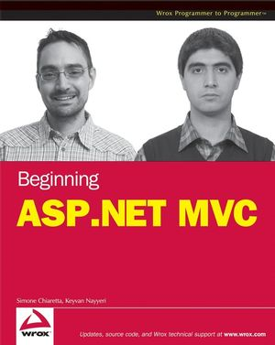
The Shameless Plug: Beginning ASP.NET MVC
Simone Chiaretta e Keyvan Nayyeri
Released on: August 3° 2009
Already for pre-sale on Amazon
TOC:
MVC
Testing
And more...
http://www.amazon.com/Beginning-ASP-NET-MVC-Simone-Chiaretta/dp/047043399X/

Slide 8
Contacts – Simone Chiaretta
MSN: simone_ch@hotmail.com
Blog:
English: http://codeclimber.net.nz/
Italiano: http://blogs.ugidotnet.org/piyo/
Twitter: http://twitter.com/simonech

Slide 9
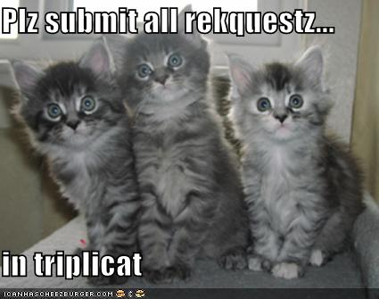
Q&A

